Slide 1
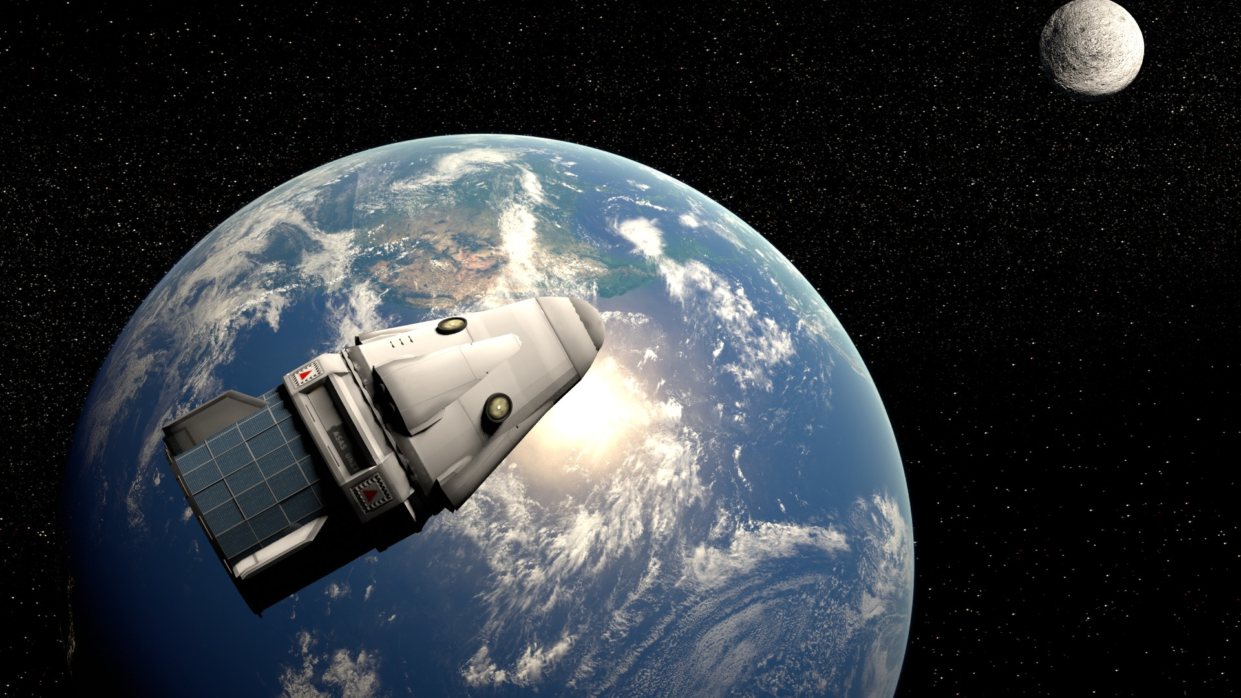
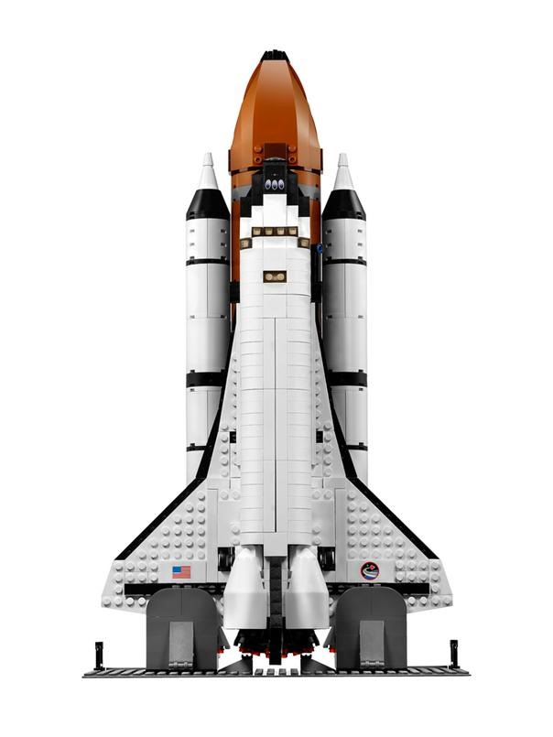
Real-Time Spacecraft Configuration and Monitoring
R Aravind 1OX14CS063
Rakshith Patil 1OX14CS069
S Deepak Raam 1OX14CS074
Sakir Beg 1OX14CS076

Slide 2
Abstract

Slide 3
Objective

Slide 4





Requirements

Slide 5
Methodology

Slide 6
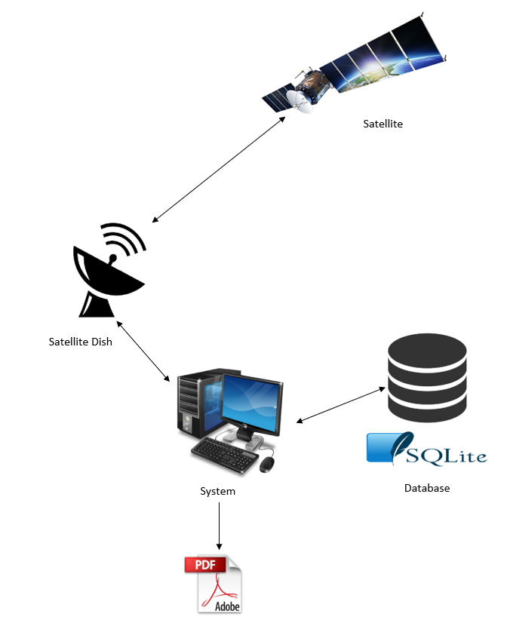
Output

